Slide 1
PowerPoint Presentation
„German Business
Culture“
a learning module
for secretaries - ELS
(ELS = European Languages for Secretaries)
funded by the EU-programme
„Leonardo da Vinci“
text-selection + translation: Karen Gehrke layout + animation: Jörg Schüler

Slide 2
German Business Culture
Index:
Unit 1: Making appointments
Unit 2: Telephoning
Unit 3: Receiving clients
Unit 4: Business dress code
Unit 5: Addressing others
Unit 6: Negotiating
Unit 7: Entertaining
Unit 8: Public behaviour
Unit 9: Regional differences
Unit 10: How to start a business
in Germany
References
Final Test

Slide 3
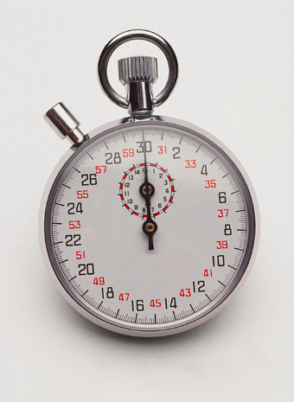
Menu
Unit 1: Making Appointments 1.1
Never underestimate the importance of punctuality in German
business culture. Arriving even five to ten minutes later than the
appointed time is perceived as late, especially if you are a
subordinate. Fifteen minutes would be considered a very serious
faux pas and could mean a shaky start to any potential business
relations.
Be prepared to make an appointment for most things. Germans don't
usually feel comfortable discussing especially serious things “on the go”,
so don't expect to be able to just drop into the office unannounced for
any detailed discussions. Make your appointments well in advance.
Give at least one or two weeks notice for an appointment made by
telephone; allow at least a month for an appointment made by mail.
If you don't have much preparation time, it's sometimes possible to
arrange for a brief, introductory meeting within a few days' notice.
If you must be late for any reason, it's important that you call and notify
the person who is expecting you. Moreover, you should give a plausible
explanation for the delay.
Questions
slide 1 (3) – use mouse-click to forward slide 2

Slide 4
Menu
Unit 1: Making Appointments 1.2
If you must be late for any reason, it's important that you call and
notify the person who is expecting you. Moreover, you should give
a plausible explanation for the delay.
The preferred times for business appointments are between 10:00 a.m.
and 1:00 p.m. or between 3:00 p.m. and 5:00 p.m.
Avoid scheduling appointments on Friday afternoons, as some offices
close by 2:00 p.m. or 3:00 p.m. on Fridays.
Casually changing the time and place of an appointment is not
appreciated. Allow for at least 24 hrs, if you can, to change or cancel
appointments. Be prepared to offer a plausible explanation.
Be sensitive to vacation and festival periods here. Germans generally
have six weeks of paid vacation, which means someone is almost
always “in Urlaub” [“on holiday”]. Therefore, be prepared to take this
into consideration when making appointments or planning visits. For
instance, Germans commonly take long vacations during the school
holidays (2-3 weeks) around Easter, in July, in August and in December.
Questions
slide 2 (3) - use mouse-click to forward slide 3

Slide 5
Menu
Public Holidays 2004 (Unit 1: Making Appointments 1.3)
01. January | New Year´s Day | Entire Germany
06. January | Epiphany | Only in Baden Württemberg, Bavaria and Saxony-Anhalt
24. February | Shrovetide carnival | Carnival in the Rhineland area, most offices are generally closed.
25. February | Ash Wednesday
09. April | Good Friday | Entire Germany
12. April | Easter Monday | Entire Germany
01. May | May Day (Labour Day) | Entire Germany
20. May | Ascension Day | Entire Germany
30./31. May | Whitsun | Entire Germany
10. June | Corpus Christi | Only in Baden Württemberg, Bavaria, Hesse, North Rhine-Westphalia, Rhineland-Palatinate, Saarland, Saxony, Thuringia
15. August | Assumption | Only in Bavaria and Saarland
03. October | Day of German Unity | Entire Germany
31. October | Reformation Day | Only in Brandenburg, Mecklenburg-West Pomeranian, Saxony, Saxony- Anhalt, Thuringia
01. November | All Saints´ Day | Only in Baden Württemberg, Bavaria, North Rhine-Westphalia, Rhineland- Palatinate and Saarland
17. November | Day of Prayer and Repentance | Only in Saxony
24. December | Christmas Eve | Entire Germany
25. December | Christmas Day | Entire Germany
26. December | Boxing Day | Entire Germany
31. December | New Year´s Eve | Entire Germany
end of unit 1
Questions

Slide 6
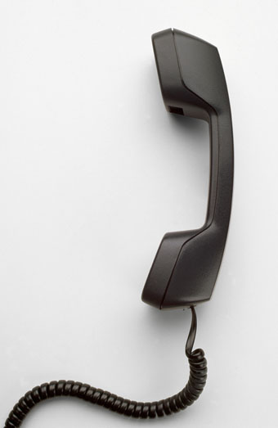
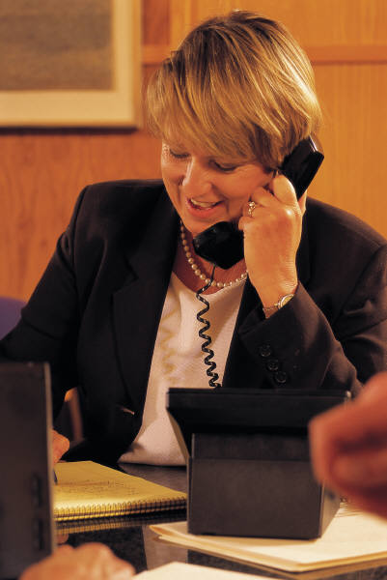
Menu
Unit 2: Telephoning 2.1
When is the best time to make a business call?
If you are calling someone who may not be expecting your call, or if
you have a matter of concern that could require a significant amount
of time to discuss, try not to place the call on a Friday. On Fridays
many business people are trying to „tie up loose ends“ before the
weekend starts.
In Germany many companies actually close at 2.00/3.00 p.m. on a
Friday.
The best time to call a company is probably between 9.00 and 11.00 a.m.
because employees are just starting the day with an open mind.
Around 2.00 p.m. might also be a good time to place a business call as
most people are back from lunch.
The worst time to call is after 4.30/5.00 p.m. because at this time of the day
accumulates the workload and soon the end of the workday is coming up.
Questions
slide 1 (4) - use mouse-click to forward slide 2

Slide 7
Menu
Unit 2: Telephoning 2.2
Typical phrases on the phone in Germany, for instance:
„Can you please connect me with ...“
„May I introduce myself? My name is ...“
„Have I caught you at a good time?“
„Do you have a second for me?“
„The reason I am calling is ...“
„I would like to arrange a meeting with you.“
„Can I call back?“
„Can you please connect me with someone I can discuss ... with?“
„May I ask your name (again)?“
„Could you please spell that?“
„You have been very helpful, thank you.“
„I appreciate your help.“
Questions
slide 2 (4) - use mouse-click to forward slide 3

Slide 8
Menu
Unit 2: Telephoning 2.3
In Germany, it is generally customary to state your name when you
answer the phone. The customary way to answer a phone at a
German company is to state the name of the company, the name of
the person answering the phone and a greeting.
For example: "Agenda 21-Projectoffice, Schmidt, Good Morning."
The name of the department may also be stated, but this differs from
company to company.
A recorded message on an answering machine at a professional place
of business should always include a few essential details, such as the
name of the business, your name and telephone number and a greeting.
It is also helpful to list your mobile and fax numbers in the recording.
In case you can not be contacted for a longer period of time, list an
emergency number or the name and number of a person who can
represent the business and deal with problems. It is important to speak
slowly and very clearly when you leave a message on the answer machine.
It is much easier for the listener to understand when you list one number
after the next, rather than combining them.
Questions
slide 3 (4) - use mouse-click to forward slide 4

Slide 9
Menu
Unit 2: Telephoning 2.4
In Germany a mobile or cell phone is called a „handy“. The word is
pronounced just as it would be in English. Many Germans think the
word is American but it is a German invention.
In Germany the mobile should be switched off at business
discussions, meetings, presentations, during meetings with
customers as well as in the theatre, in concert halls, in the cinema,
in museums, during a ceremony or a lecture and also in restaurants.
These are places where most people are sensitive to disturbances
and can become quickly irritated when a mobile begins to ring and
somebody starts a telephone conversation.
Questions
end of unit 2

Slide 10
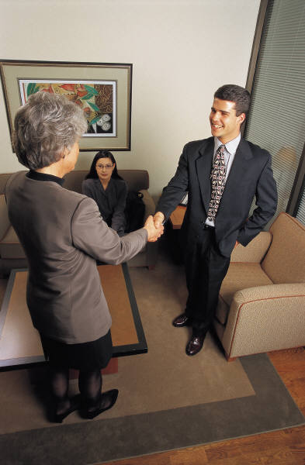
Menu
Unit 3: Receiving clients 3.1
German business people maintain a physical distance zone. A violation
of personal space can have seriously adverse effects on communication.
Therefore it is important to maintain the right physical space to the
person opposite you. A distance between 50 cm (~ 20 in.) and about
one meter (~3.3 ft.) allows the most common form of greeting in Germany –
the handshake. If a handshake takes place too closely (nose to nose), this
could cause an awkward situation.
Pecking order: Who shakes whose hand?
In Germany, shaking hands is a common custom. However, who initiates
a handshake can be more perplexing than you might expect. In deciding
wheater or not to initiate a handshake when introducing yourself, keep the
following in mind:
- The colleague higher up the corporate hierarchy always has the „handshake
initiative“, or the right to offer his or her hand first.
- If you approach a group of people, you should always extend your hand and
introduce yourself.
- To show respect, always extend your hand to older individuals first.
Questions
slide 1 (2) - use mouse-click to forward slide 2

Slide 11
Menu
Unit 3: Receiving clients 3.2
However, the hierarchy mentioned above does not just apply in
close circles within an organisation. It is generally important, when
faced with a tricky situation, that you develop a sixth sense as to
who assumes the „handshake initiative“ and who does not.
Observe those around you to get clues or ask a trusted colleague.
Some rules of conduct:
- When entering the lift you should let your client/boss go first.
- When leaving the lift it is better to be logical. The people that are standing
at the front of the lift should be the first to exit to avoid a crush.
- In a professional setting the initiative to shake hands is always left to the one who
holds a higher position in the company. Position wins out over age and gender.
- Always address colleagues and business partners with their academic titles
until they tell you to do otherwise.
- Women do not remain seated when greeting a business partner. It is
always recommended that you stand up when greeted so that you are
on the same eye level with your visitor. This makes it easier to get
involved in a discussion. Both women and men who take their hosting
role seriously should stand up anyway.
- It is considered polite to open the passenger door from the outside for
the other person who is riding with you.
Questions
end of unit 3

Slide 12

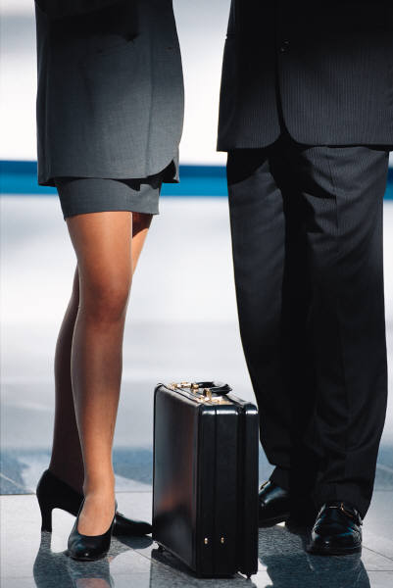

Menu
Unit 4: Business dress code 4.1
Dress in corporate business and banking is generally formal,
dark and conservative suits for both men and women.
Otherwise, business dress is relatively casual. Suits are seldom
worn by clerks and other office staff, and are standard dress for
only managers at the upper levels.
In banks, men tend to be more formally dressed than their female
co-workers, often attired in suit and tie. Dress codes in the
IT-sector are very casual.
In the office and in the team assistance the following clothes should
be avoided by serious customer and career-orientated women:
Very short mini-skirts, shirts or tight sweaters with revealing
neck-lines, transparent and very tight clothing.
Cloth made off gold- and silverlamé or lurex are not well perceived
just as nappa leather, spaghetti straps, extremely high heels, wildly
patterned tights and naked legs.
Khakis with a simple jacket/blazer would be inappropriate,
especially for first meetings or contacts.
Questions
slide 1 (4) - use mouse-click to forward slide 2

Slide 13
Menu
Unit 4: Business dress code 4.2
Germans tend to dress in more conservative, muted colours,
both in business and social environments. You will notice,
too, in both social situations and on a daily basis that Germans
tend to “dress up” much more than, for example, North Americans
when they go out.
This goes as much for walking the dog or shopping at the
supermarket as for going to restaurants and cafes. Very casual
sporting attire is seen on mostly young people. Dress shoes
worn with jeans and a tastefully-coordinated ensemble is quite
normal for adult men and women.
Women should also avoid excessively ornate jewellery or
displaying items of conspicuous wealth, especially in the former
East Germany.
The standard of living in this area of Germany is still lower than
that in the western part and displays of affluence can cause
resentment.
slide 2 (4) - use mouse-click to forward slide 3

Slide 14
Menu
Unit 4: Business dress code 4.3
When you receive an invitation stating “informal” dress, don't
assume you'll be welcome arriving in a T-shirt and sweatpants.
For a social gathering, informal more often than not means
tastefully coordinated clothes, although not necessarily a jacket
and tie for men. An invitation stating “formal” dress usually means
formal eveningwear, which is very dressy by American standards.
Most restaurants do not require a tie for men, although the
upscale establishments expect both men and women to arrive
well dressed. [Important related side note: Patrons of restaurants
are normally free to select their own tables and seat themselves.
In very upscale establishments, however, guests will more likely
to be shown to their seats.]
Questions
end of unit 4

Slide 15
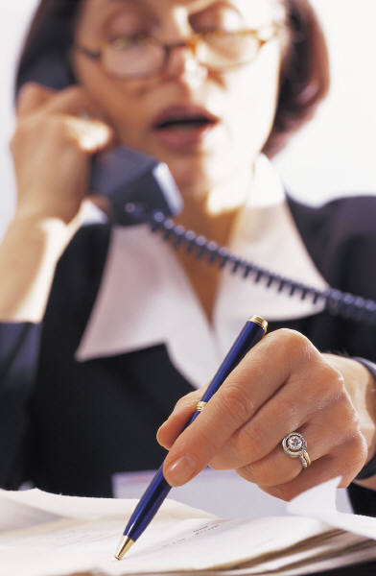
Menu
Unit 5: Addressing others 5.1
Addressing someone:
Should I use „Du“ or „Sie“?
Making the choice between „Du“ („you“ familiar) und „Sie“
(„you“ formal) is not only a problem for foreigners.
Determining who should address whom, how, and when, differs
from place to place, from industry to industry, and even from
company to company. The use of „Du“ or „Sie“ can be an
important indicator of the type of relationship that people have
with each other.
As a general rule, „Sie“ should be used unless somebody offers
you to use „Du“ straight away. The use of „Sie“ also indicates
that there is a recognized distance between two people, and
that they don´t know each other on a personal level. If you
address someone with „Sie“ you would also address her/him
with their title („Frau“, „Herr“, „Dr.“ etc.) and her/his last name.
For example, „Frau Ullrich, do you have a minute for me?“)
Questions
slide 1 (6) - use mouse-click to forward slide 2

Slide 16
Menu
Unit 5: Addressing others 5.2
In German business culture, it's not uncommon for colleagues
who have worked together for years to remain on a formal, last
name basis. This can reflect, on the one hand, a pronounced
institutional hierarchy in German society which requires a degree
of formality. On the other hand, the formal “Sie” can also be used
to impose psychological and emotional distance between oneself
and another person, if this is desired.
Addressing someone with her/his first name and „Du“ is usually
reserved for family members, as well as friends and close colleagues.
The use of „Du“ is something personal. It expresses to everyone that
two people understand each other not just on a professional level,
but on a personal level as well.
Questions
slide 2 (6) - use mouse-click to forward slide 3

Slide 17
Menu
Unit 5: Addressing others 5.3
If a German offers you the use of „Du“ which means she/he
suggests to “duzen”, you should not worry about insulting or
showing disrespect to her/him.
The general rule would be to always use “Sie” unless someone
specifically offers you the “Du”. [Note that among students and
younger people, “duzen” right from the beginning is the standard.]
In delicate situations, as in more formal business relationships,
using „Du“ too quickly may cause a feeling of mistrust rather
than helping to build the trusting relationship that one might expect.
If a switch from „Sie“ to „Du“ is made too hastily, a German could
get nervous and think, „Can I actually trust the person enough to
address her/him with „Du“?“
Questions
slide 3 (6) - use mouse-click to forward slide 4

Slide 18
Menu
Unit 5: Addressing others 5.4
The question as to who should be the first to address whom with
„Du“ can be answered with a glance at the corporate hierarchy.
An employee, regardless of her/his position, should always leave
it to the boss to address her/him with „Du“ first. But also the boss
should not, without prior consultation, address her/his employee
with the use of „Du“ instead of the common „Sie“ as it would
express a lack of respect towards her/him.
A new trend is spreading both in German private life (among
elderly people) and in the business world known as the
„Hamburger Sie“, which is a combination of using „Sie“ and
addressing someone by her/his first name. For example:
„Inga , could you help me?“
This would be a normal way to address someone in Hamburg.
Questions
slide 4 (6) - use mouse-click to forward slide 5

Slide 19
Menu
Unit 5: Addressing others 5.5
“Dr.” can be a medical or academic title, and is often used,
especially among Germans, as part of their names [e.g. in
passports, in phone books, on official documents, all forms
of official addresses, etc.]. Accordingly, Dr. Martin Meyer
should be addressed as “Herr Doktor Meyer”. If you are going
to meet a professor, address him/her as Herr [or Frau]
Professor [Surname]. Accordingly, Prof. Dr. Karin Schmidt
should be addressed as “Frau Professor Schmidt”.
“Fräulein” is very much out of fashion today. Once a girl comes
of age, she is normally addressed as “Frau” in public.
When shopping and entering a shop it's common courtesy here
to say “Guten Tag” [“hello”] upon entering an establishment, and
later “Vielen Dank, auf Wiedersehen” [“thank you, goodbye”]
when leaving. Greeting strangers on the street, however, with a
“hello” or “Guten Tag” is not expected and you may well get no
reaction despite there having been direct eye contact.
Questions
slide 5 (6) - use mouse-click to forward slide 6

Slide 20
Menu
Unit 5: Addressing others 5.6
Any effort, small or large, to learn and use some basic
expression of courtesy will be appreciated.
These might include:
“Thank you”
“Thank you very much”
“You're welcome”
”Hello”
“Good morning”
”Good afternoon“
“Good evening”
“Can you help me?”
“Do you speak English?”
Questions
end of unit 5

Slide 21
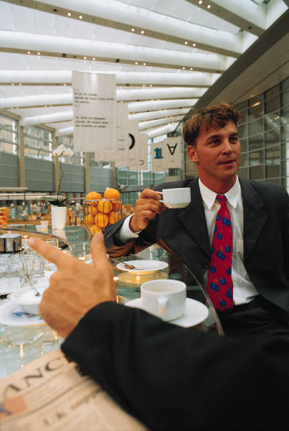

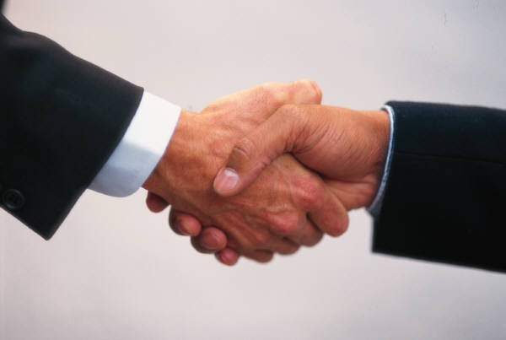
Menu
Unit 6: Negotiating 6.1
Unless you are in the IT branch of business, meetings normally follow
a formal procedure presided over by the chairperson of the meeting.
Follow the example of the other participants as to how informal or
formal you should act, dress, and sit. If it is the very first meeting for
you in Germany or in a particular company and you are unsure about
in-house procedures, do not hesitate to ask your host in private what
you should expect or do. Do not think that this would put your host in
any uncomfortable or awkward position; neither should you yourself
feel embarrassed about having to ask. Germans are very
straightforward and direct, especially in the business environment.
It is part of their normal communication behaviour for someone to
openly ask for clarification. In case somebody did not understand
instructions or expectations it helps to prevent complications.
The German side will arrive at the meeting well-informed, and will
expect the same from you. Even at initial meetings where, in your
culture, you may spend most of the time getting acquainted and
building a personal relationship between you and a potential business
partner, expect the Germans to address issues, problems and facts
through very technical communication behaviour. If this is not your
intention in the initial meetings, make a point of clarifying your intentions
and expectations beforehand.
Questions
slide 1 (5) - use mouse-click to forward slide 2

Slide 22
Menu
Unit 6: Negotiating 6.2
Contracts are final after signing. Failure to honor the terms and
conditions of a signed contract can lead to legal action taken
against the partner. Businesspeople from cultures that traditionally
regard contracts as mere “statements of intent” should not expect
German enterprises to be able to adapt too much to this way of
thinking. Attempts to continue negotiations or revise fixed terms will
create distrust and suspicion and may be grounds to terminate the
agreement.
German businesspeople tend to be traditionally cautious of new
ideas and concepts. Institutional change comes slowly and often
quite reluctantly. Therefore, German businesspeople do not
respond as much to the “sell” as North Americans and Australians,
which are “high risk-taking” cultures. Tone down the “hype” and
provide lots of logical argumentation and concrete examples to
back up your proposal based on much more facts and data than
you would use in your home culture.
Questions
slide 2 (5) - use mouse-click to forward slide 3

Slide 23
Menu
Unit 6: Negotiating 6.3
Flexibility and spontaneity are not prominent traits in German
business culture. The bigger and older the institution, the more
slow-moving internal management will tend to be. Risk-taking,
or challenging rules and traditional authority are not considered
desirable, partly because of institutional hierarchy, but also, why
change something that has proven itself through time?
Detailed planning has enormous value in German culture and is
a principal characteristic of German business co-operation. This
can turn out to be a smooth marriage between partners or lead
to one partner feeling hen-pecked by the other. All participants
rely on exchanging and clarifying details to move a project forward.
It is rather a question of how much detail at what point. Both sides
should do their homework beforehand and perhaps schedule a few
informal meetings to address these issues and set some basic
ground rules that everyone can agree on.
Questions
slide 3 (5) - use mouse-click to forward slide 4

Slide 24
Menu
Unit 6: Negotiating 6.4
Ensure you have plenty of data and empirical evidence to support
your proposals and arguments. If you are conducting the meeting
in German, keep the language simple and direct. Even when you
think you sound much more direct than you would ever be in your
own native language, keep in mind that this will not likely be the
case for German ears. Too much diplomatic indirectness will be
confusing and irritating for Germans and can give the impression
of insincerity and beating around the bush.
When you are preparing promotional or presentation material, be
aware that German businesspeople are less impressed by glitzy
advertising and memorable slogans. Brochures aimed at the
German market provide technical data, hard facts and examples.
Don't worry about producing a brochure that seems lengthy or
tedious; if the information is pertinent a German will be inclined to
read the whole thing.
Questions
slide 4 (5) - use mouse-click to forward slide 5

Slide 25
Menu
Unit 6: Negotiating 6.5.1
Germans will sometimes look for deficiencies in your products or
services and will quite openly draw your attention to them, this is
the toughest aspect of German communication behaviour. This
form of direct disagreement and criticism is possible because such
a statement is based on objective, impersonal truths. Ultimately,
the value lies in pointing out a mistake to someone so that it can
be corrected.
Similarly, Germans have no problems saying “no”, “I can't”, or
“This is impossible” if that is what they mean. If a rule says
something cannot be done, or if the person doesn't eat a certain
type of food, he or she will likely say so --not due to any intended
insensitivity or discourtesy toward the other's feelings, but as a
simple statement of fact. In the event, even if you may feel
uncomfortable, keep to the facts, be prepared to apologize [but not
excessively!] for any errors and be in a position to provide a very
plausible explanation or solution.
More ►►►
Questions
slide 5 (5) – end of unit 6

Slide 26
Menu
Unit 6: Negotiating 6.5.2
Germans can be sensitive to criticism themselves. You should be
aware of saying or doing anything to embarrass them publicly.
Practice diplomacy whenever you can.
You must be prepared for German business-partners to show less
restraint in revealing their personal mood and emotions in public.
It can be possible, for example, that they are showing annoyance.
German businesspeople will not make concessions easily. They
will, however, look for common ground and this is your best route
to making progress when negotiations reach an impasse. Be
warned that any attempts to be aggressive and confrontational
with a German company are usually counterproductive.
Germans, generally, are very private people. Therefore, do not
discuss personal matters during business negotiations. Nonetheless,
despite their value of keeping business and private relations separate,
it is not at all impossible to cultivate relationships on more personal
terms with your business partner. (continue – next slide)
Questions
(More) slide 1 (3) - use mouse-click to forward slide 2

Slide 27
Menu
Unit 6: Negotiating 6.5.3
Simply realize that Germans need more time to form relationships
on a personal level. At the beginning of a new relationship, don't
feel you need to go to as much trouble or show as much
enthusiasm as you may normally do in your home country or with
others from similarly relationship-oriented cultures. This will not be
expected, and excessive efforts to force a personal level of contact
can leave the other with an uncomfortable feeling of obligation to you.
Decision-making in German business culture is slow, protracted,
and every detail relating to your proposal will be examined.
Therefore, do not expect substantial decisions to be made
spontaneously at the table. However, once a decision is finally made,
it is extremely difficult to change.
In German culture, rules of any kind are meant to be taken seriously.
Moreover, if you break the rules, you can be reprimanded. You will
have to make an effort to become sensitive to the implicit and explicit
rules that shape this society.
At the end of a meeting or presentation, Germans often signal their
approval or thanks by gently rapping their knuckles on the tabletop
instead of applauding.
Questions
(More) slide 2 (3) - use mouse-click to forward slide 3

Slide 28
Menu
Unit 6: Negotiating 6.5.4
The “Q & A exam”:
Questions in meetings will often come hard and fast after a brief
introduction of persons. You may often be interrupted in the middle
of your answer, once the other party has the feeling of having
received a satisfactory answer to his question, at which point he will
move on to his next question. This will be especially tricky and quite
uncomfortable if you happen to be alone, sitting across the table
from four or five Germans.
Interruptions are also quite common if the other person has the feeling
you are getting off topic. Persons from highly relationship-oriented
cultures, where emotional comfort and the preservation of “face” has
priority over truth-based facts, must therefore be careful of being run
over” in meetings and discussions with fact-oriented communicators.
Typically, the former is conditioned to “give way” for the sake of group
harmony, while the latter is focused on the logic and integrity of the
facts of an argument and feels no restraint in carrying out his or her
point. Interruptions are effective tactics for being heard in a discussion.
Germans will often continue to speak, or continue to speak louder in
order to avoid being interrupted by someone else. In such cases, one
continues to speak until the other simply gives way.
Questions
(More) slide 3 (3) – use mouse-click to forward slide 7

Slide 29

Menu
Unit 7: Entertaining 7.1
It is traditional in Germany to eat the main meal of the day at
lunchtime, between 12:00 a.m. and 1:30 p.m.
In contrast to a long, several-course meal, a German lunch usually
consists of an appetizer (usually soup), a main course, and a dessert.
When you are attending a business conference, both lunch and dinner
are considered important components of the conference. Meals allow
those attending to make personal contacts and to continue discussing
business issues in a more casual atmosphere.
Contrary to earlier traditions that frowned upon women speaking with
the waiter, tasting the wine, or paying the bill, all of these things are
normal today. It is not only acceptable for a woman to ask for the bill,
but also to enter a restaurant first, and - if acting as hostess - to try the
wine before it is served. However, this last situation will usually not come
into question at business luncheons because, in most cases, only non-
alcoholic beverages are served.
Questions
slide 1 (6) – use mouse-click to forward slide 2 (6)

Slide 30
Menu
Unit 7: Entertaining 7.2
Alcoholic Beverages
The consumption of alcohol in Germany (even during the work
day) may be more common than you are used to in your country,
and when others drink, you may feel pressured to drink as well.
Again, you don't need to worry - it is acceptable to refuse a drink.
In fact, you can even offer to order drinks for others and refrain
from drinking alcohol yourself.
Leaving a Tip
Generally, the rule states that 10-15% of the bill's total should be
left as a tip if you were satisfied with the service you received.
If you weren't satisfied, you can simply not leave a tip, and others
will not frown upon you. You may, on the other hand, want to leave
more than the standard 10-15% tip if the restaurant staff really went
out of their way to accommodate your needs. Also, when leaving, it
is polite to thank the staff or your waiter / waitress with, "Dankeschön."
("Thank you.") This lets you express your appreciation in addition to
the tip that you leave behind.
Questions
slide 2 (6) – use mouse-click to forward slide 3 (6)

Slide 31
Menu
Unit 7: Entertaining 7.3.1
Specific Questions:
1. When in Germany, should I conform my table manners
to those of the Germans?
For the most part, you do not have to make too much effort to mirror
the Germans at the table. If you practice good table manners at
home, they will suffice in Germany; it is not necessary to worry
about how to hold your fork or where to place your napkin. But be
careful - some behaviour should be avoided. For example, in
Southern Asia, it is normal to chew loudly when eating and to belch
after a good meal. If you were to do this in Germany, it could embarrass
you as well as those sitting with you.
2. What are a few table manners that I should keep in mind in Germany?
For more information click on the “More”-button.
More ►►
Questions
slide 3 (6) – use mouse-click to forward slide 4 (6)

Slide 32
Menu
Unit 7: Entertaining - More 7.3.2
2.1 What are a few table manners that I should keep in mind
in Germany?
Before eating, wish everyone at the table "Guten Appetit." ("Enjoy your
meal.")
Only take as much food as you plan on eating. The Germans usually
"clean their plates".
When you or others are eating, keep your hands on the table, not under it.
Sit up straight, close to the table.
Don't prop your head up with your hands.
Don't bend your head over your food when you are eating or
"shovel" your food in your mouth.
Don't begin eating until everyone at the table has been served.
When eating, always use utensils; very few foods here are intended
to be eaten with the hands. North Americans will be surprised to find
that even pizzas are eaten with a knife and fork, unless sold by the
piece to go.
Questions
(More) slide 1 (2) - use mouse-click to forward slide 2 (2)

Slide 33
Menu
Unit 7: Entertaining - More 7.3.3
2.2 What are a few table manners that I should keep in mind
in Germany?
In Germany, the knife is used much more actively throughout the
meal. Eating with only one hand, with the other hand placed on one's
lap under the table is not desirable.
Don't begin drinking until everyone has something to drink and a toast
has been made.
Look others in the eye when toasting.
Do not get up to leave when you have finished eating, but wait for
the others; if you came to dinner with others, then leave with them
also.
Do not belch or chew with your mouth open. This is considered very
bad table manners not only in Germany but throughout Europe.
When you are finished eating, places your knife and fork together
and rest them on your plate.
Questions
(More) slide 2 (2) - use mouse-click to forward slide 7.4

Slide 34
Menu
Unit 7: Entertaining 7.4
3. Should a host pay the bill at the table with the guests present?
No! It is much more polite to pay the bill at the bar in order to avoid
misunderstandings or discussions about paying. This also allows
the host to inconspicuously pay, look over the bill, leave a tip, and
order an aperitif for everyone.
4. Is it acceptable to ask for the house wine in a good restaurant?
Yes! A good house wine is a good advertisement for a restaurant. Also,
you can be sure that a wine from wine countries such as Germany,
France, and Italy will never be of bad quality. When your budget doesn't
allow an extremely expensive wine, ask the waiter to recommend a low
cost, quality wine. By naming the amount that you are willing to spend,
you show that you are confident in the situation and not embarrassed to ask.
5. When I order soup, is it polite to tip up my soup cup and drink the
last bit of soup?
Yes! However, in order to do this tactfully, take hold of one of the soup
cup handles, tip, and drink. Keep in mind that this is only polite when your
soup comes served in a CUP, not a bowl!
Questions
slide 4 (6) - use mouse-click to forward slide 5

Slide 35
Menu
Unit 7: Entertaining 7.5
6. Is it appropriate to use toothpicks or put on lipstick at the table?
Yes! These are not the most tactful things to do at the table, but if
they have to be done, then go ahead. Lipstick can be put on
discretely almost anywhere, but is it really necessary to put it on at
the table? If you really want to freshen up your make-up, be sure to
go to the bathroom.
7. When I attend a social event, should I wait to take off my sport
coat or jacket until I am asked to do so by the host?
Yes! Good hosts and hostesses should react quickly when they notice
that the room temperature is rising and offer to take your coat for you.
8. Is it true that I should not lay my paper napkin in my plate when
I am finished eating?
Yes! In Germany it is customary to fold your napkin after eating and place
it to the left side of your plate. The Germans have a very strict recycling
system, and this helps ensure that the napkin ends up in the correct
recycling bin. Cloth napkins should also be folded and laid to the left side
of your plate, never in the plate!
Questions
slide 5 (6) - use mouse-click to forward slide 6 (6)

Slide 36
Menu
Unit 7: Entertaining 7.6.1
9. If I would like to say a few words at the table or to make a
toast, is it appropriate to bang on the side of my glass to
get people's attention?
No! Although you typically see this in old German movies, today it
is more appropriate to stand and ask for their attention in a slightly
raised voice. Those seated at the table should automatically stop
talking and pay attention.
For more information click on the “More”-button!
More ►►►►►
Questions
slide 6 (6)

Slide 37
Menu
Unit 7: Entertaining - More 7.6.2
Breakfast meetings are not part of German business culture.
However, when Germans get together for dinners after business,
talk often remains about business; especially as Germans generally
find it difficult to do small talk with people they don't know well.
Business talk mixed with a pinch or two of general personal
conversation tends to be the mix with which many German
businesspeople are most comfortable.
German businesspeople, as a rule, do not make business decisions
during mealtimes. Follow the example of your German dining
companions and wait for them to initiate any discussions about
business.
Except for a few official dinners, do not expect your German
hosts to entertain you with an evening program every day.
They will expect you to want to have some time to yourself.
This is because Germans themselves clearly separate private
time from their professional duties.
Questions
(More) slide 1 (5) - use mouse-click to forward slide 2 (5)

Slide 38
Menu
Unit 7: Entertaining - More 7.6.3
In some of the more informal restaurants during peak hours, you
may be asked if you would mind sharing a table with other patrons,
instead of waiting for a free table. If this happens, and you accept,
you are not obligated to initiate conversation with your tablemates
and socialize with them throughout the meal.
Non-smoking sections in restaurants are still uncommon in most
European countries. North Americans, especially, should refrain on
exercising their “non-smoker rights” too vocally here, as this can
provoke aggression and will be met with very little public support.
The person who extends the invitation will be the person who pays.
It is not at all expected that the guest should even offer to pay.
Especially East Asians should refrain from their typically dramatic
and persistent efforts to obtain the bill, as this will not only create
confusion and embarrassment in their German hosts, but in some
cases it could be that they do, in fact, end up with the bill.
(More) slide 2 (5) - use mouse-click to forward slide 3 (5)

Slide 39
Menu
Unit 7: Entertaining - More 7.6.4
Don't forget: Germans are likely to take your insistence literally!
Similarly, businesspeople from other cultures should not expect a
“fight” for the bill from German guests. If they are the guests, it will
be clear for them who are paying.
Dinner is usually served from 7:00 p.m. to 8:30 p.m., and this is also the
customary time for dinner parties to begin. Consequently, dinner parties
usually end at around midnight or later.
A very important note: if a German colleague or friend merely suggests
that you go out together to get something to eat, this is not to be taken as
an invitation!
In other words, he will not be offering to pay. Typically, in German
restaurants, the waiter will come at the end of a meal and ask if the total
should be “zusammen” [totalled together on one bill] or “getrennt”
[separate bills].
Unless you have been explicitly “eingeladen” [“invited”], you can expect
the waiter to be asked for separate bills, where the waiter will add together
what you have just eaten and you will be paying him directly at the table.
Questions
(More) slide 3 (5) - use mouse-click to forward slide 4 (5)

Slide 40
Menu
Unit 7: Entertaining - More 7.6.5
German cuisine is traditionally heavy on the meats and sauces.
This may present problems for people with special diets [health
reasons, religious beliefs, vegetarians, allergies, etc.]. However,
the important point here is that it will not cause irritation or
embarrassment for your German hosts if you inform them of these
restrictions directly. Directness does not have a negative value in
German culture, provided you communicate your needs politely,
reasonably and in advance. Do not always expect Germans to ask
you if there is anything you do not eat. Because Germans are direct
communicators, they will expect someone to speak up if they want
something, disagree about or don't like something. Irritation and
inconvenience will rather result if you remain silent and “spring” the
problem on the host only when the dishes are being served. If you had
enough and you do not want any more food or drink, say so politely.
Germans do not often entertain business associates in their homes.
If you are invited to a home however consider it a relationship-building
gesture. You may be invited to a sit-down dinner in the evening, or a more
common invitation is for afternoon “Kaffee trinken” [“drinking coffee”, which
basically means “eating cake”].
Questions
(More) slide 4 (5) - use mouse-click to forward slide 5 (5)

Slide 41
Menu
Unit 7: Entertaining - More 7.6.6
Sit-down dinner parties begin quite punctually. If you must be late for any
reason, it's important that you notify your hosts and that you give a short
explanation for the delay.
Do not presume to seat yourself at a gathering: whenever possible, wait to
be told where to sit [or wait for the host to tell you to sit wherever you like].
The most honoured position is at the head of the table, with individuals of
the greatest importance seated first to the left and then to the right of the
head of the table. If a couple is hosting, often one will be at one end of the
table, the other at the opposite end.
Only very occasionally, at more formal dinner parties, couples may be broken up
and seated next to people they do not know. The intention of this arrangement is
to introduce new acquaintances and promote conversation, especially if the
guests are an international mix and more comfortable with small talk.
The most common toasts are “Zum Wohl!” [with wine] and “Prost!” [with beer],
both of which generally mean a wish for good health. When making a toast, it is
important to maintain direct eye contact. If many people are being toasted, make
eye contact with each individual around the table as you make the toast. This rule
becomes even more important to remember as you move west to east through
Germany.
If those around you are not smoking, you should ask permission before lighting up.
Questions
(More) slide 5 (5) – unit 8 by mouse-click

Slide 42
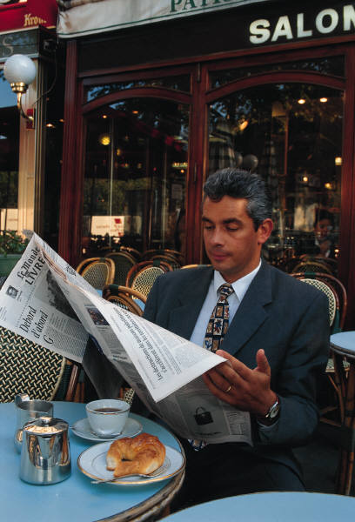
Menu
Unit 8: Public behaviour 8.1
If you do not speak German, be careful of automatically
addressing a person in English. While Germans generally
speak very good English but there is some noticeable
resentment among especially the 45 to 60 age group, which
generally doesn't feel as secure in the language as the next
younger generations, which have grown up with a lot more
knowledge of English.
Germans do not expect to be greeted by strangers, even when eye
contact has been made, in the office environment. The fact-oriented
thinking is, “since I don't know this person, there is no relationship, so
there is no need to get into superficial pleasantries”. Generally, the
smaller the office is, the more greetings will be forthcoming and
expected, but the bigger the environment is, the less it will be expected
and offered, especially if you are not a permanent member of the staff.
Generally, Germans prefer third-party introductions whenever possible.
They will not expect to be approached by complete strangers and will
not as a rule do the same to establish some points of commonality
through fluent small talk.
Questions
slide 1 (4) - use mouse-click to forward slide 2

Slide 43
Menu
Unit 8: Public behaviour 8.2
Institutional hierarchy in Germany is well defined, and is quite
obvious in the individual's communication behaviour. Corporate
rank demands a degree of privilege and respect from
subordinates. Keep in mind that to whom, when and the way
you are introduced will indicate how you are perceived and how
Germans fit you into their corporate hierarchy.
Firm, brief handshakes at the time of arrival and departure are
standard. Hugging and kissing on both cheeks are common only
among good friends and family members. When arriving and leaving,
take the time to shake hands with everyone individually in a group.
Eye contact during the introduction should be maintained as long as
the person is addressing you.
Even in public between strangers, eye contact can be direct and not
necessarily smiling. It would be wrong, however, to assume that all
stares in public are meant to be threatening. Nonetheless, do not
expect direct eye contact to necessitate some greeting or acknowledgement;
the German will also not expect anything from you. Unfortunately this can
result in a mistaken perception of the Germans as cold and unfriendly.
slide 2 (4) - use mouse-click to forward slide 3

Slide 44
Menu
Unit 8: Public behaviour 8.3
Before crossing the street, pedestrians are expected to wait
patiently on the curb until the light turns green.
Although Germans are usually very formal, pushing, shoving,
and other displays of impatience in line-ups are not uncommon.
Apologies are in such cases not necessarily the rule. Queuing
and waiting your turn are not strong traits of the Germans.
Be prepared to move yourself and your goods fast through the
checkout line at the supermarket. Here you can get a good look
at how “time-dominated” cultures work. Pitching your groceries
into your bag or shop-cart, digging out your money and pocketing
the change, and getting out of there as fast as you can. If you take
your time, be prepared for some sour looks!
In bureaucratic institution you should queue up and wait until it's
your turn. In the case that you only look like you might have a request
before it's your turn, the clerk might tell you in no uncertain terms that
a person “can't possibly do two things at once!”
Questions
slide 3 (4) - use mouse-click to forward slide 4

Slide 45
Menu
Unit 8: Public behaviour 8.4
In Germany you will be confronted with an aggressive
“driving culture” on the famed German autobahn.
Germans can be very impatient and aggressive drivers.
Reaction time on German roads is much shorter than,
say, in North America, where lower speed limits and
plentiful space enable a driver to simply take his or her
time. Tailgating is very common and quite aggressive,
especially on the left lane of the autobahn, where
etiquette dictates that slower vehicles give way immediately
by moving to the right lane. The absence of a speed limit
also means that one is always catching up to the next car
out in front and having to pass. Be prepared for much more
“chasing”, which can make autobahn driving much more
stressful.
Questions
end of unit 8

Slide 46
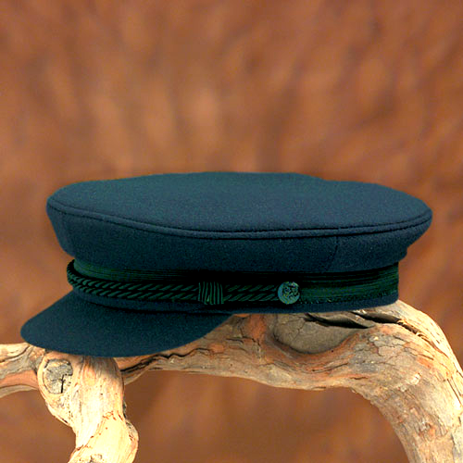
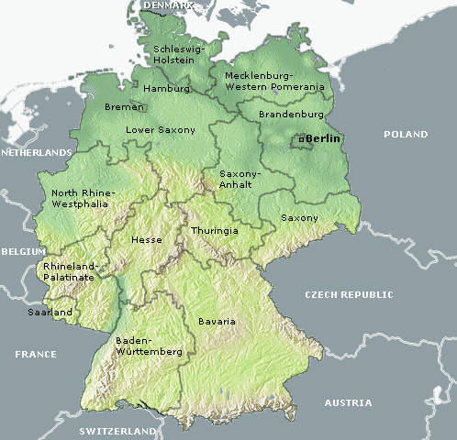
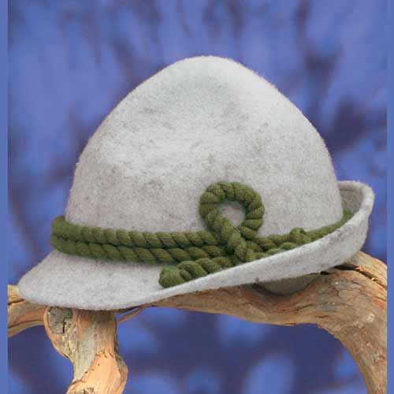
Menu
Unit 9: Regional differences 9.1.1
Germany – general overview:
The Federal Republic of Germany is situated in the heart of
Europe. It has nine neighbours: Denmark in the north, the
Netherlands, Belgium, Luxembourg and France in the west,
Switzerland and Austria in the south, and the Czech Republic as
well as Poland in the east. This central location has been more
pronounced since 3 October 1990 when Germany was reunited.
The Federal Republic is more than ever a link between east
and west, but also between Scandinavia and the Mediterranean.
As a member of the European Community and NATO, Germany
is a bridge to the countries of Central and Eastern Europe.
Germany covers an area of 357 023 sq km. The longest distance
from north to south as the crow flies is 876 km, from west to east
640 km. Germany has a population of 82.44 million, the largest in
Europe after Russia's, followed by Italy (population 58 million), the
United Kingdom (57 million) and France (56 million). In size,
however, Germany is smaller than France and Spain.
More ► map of Germany
Questions
slide 1 (5) – use mouse-click to forward slide 2 (5)

Slide 47
Menu
Unit 9: Regional differences 9.1.2- map
http://www.deutschland.de/aufeinenblick/deutschlandkarte
Questions
map (9.1.2) – use mouse-click to forward slide 9.2

Slide 48
Menu
Unit 9: Regional differences 9.2
There are many regional differences in Germany, for example:
Geographical differences:
Germany has various landscapes. Low and high mountain ranges
intermingle with upland plains, terrace country, hilly regions and
lake-lands, as well as wide, open lowlands. From north to south
Germany is divided into different topographical zones: from the
North German Plain, the terrace panorama of the southwest to
the Bavarian Alps.
Language and dialects:
German is spoken in Germany, Austria and Switzerland. The
German language is a hodgepodge of dialects and linguistic
variations stretching from the Danish border to northern Italy
(e.g. in the region of Südtirol they speak German). The German
spoken by a Berliner is worlds apart from the German spoken
by a Bavarian in Munich. Swiss German, Schwyzerdütsch, is
Chinese to the ears of someone from Düsseldorf.
(continue - next slide)
Questions
slide 9.2 - use mouse-click to forward slide 9.3

Slide 49
Menu
Unit 9: Regional differences 9.3
The regional dialects of Austria are like dozens of different
languages, making it difficult for a Viennese to understand
an Innsbrucker. The only way any of these various
German-speakers are able to communicate is through a
relatively standardized form of German known as Hochdeutsch,
or High German. The hoch in Hochdeutsch refers to a
topographically higher region, relative to the lower (nieder) or
flat (platt) regions of northern Germany. The term "High German"
does not imply any superiority to "Low German" -- the only
differences are geographic and linguistic.
In the last 10 to 15 years there has been a conscious effort to
preserve local and regional dialects in the German-speaking
world. Many Austrians, Swiss, and Germans have a renewed
pride in their own unique dialect. They see Hochdeutsch as
useful and necessary, but they don't want to see their own
regional cultural identity fade into a uniform, bland sameness.
Questions
slide 9.3 - use mouse-click to forward slide 9.4

Slide 50
Menu
Unit 9: Regional differences 9.4
Religion:
Religions: Christians 66 % (Catholics 33 %, Protestants 33 %),
Muslims 3 %, Jews 0.1 % and others.
The Christians are split evenly between Roman Catholics, who are
concentrated in the southern part of the country, and Protestants,
who are found in the northern region.
East- and West-Germany:
Germany went through a unification process, bringing the East
the West together (1990). Although there still continues to be
sensitivities between the two regions, the integration both
economically and technologically is moving forward. The
unemployment rate in the east is a lot higher than in the west.
The economic situation of the population in the east is often worse
than in the west.
Questions
end of unit 9

Slide 51

Menu
Unit 10: How to start a business in Germany 10.1
Association of German Technology
and Entrepreneurial Centers
Here innovation is writ large: technology and entrepreneurial centers
as well as science and technology parks are the focus of this federal
association. The Association of German Technology and Entrepreneurial
Centers (Arbeitsgemeinschaft Deutscher Technologie- und Gründer-
zentren e.V., ADT) actively assists entrepreneurs and supports research
and technology centers. The ADT offers members a number of services
in the areas of purchasing, sales and management.
Visitors to this website can access publications and projects, find tips on
public tenders and promotional programs or make use of international
networks of cooperation.
www.adt-online.de
German Venture Capital Association
Do you have a start-up idea and need venture capital for your enterprise?
Start your research at the Bundesverband deutscher Kapitalbeteiligungs-
gesellschaften – German Venture Capital Association e.V. The goal of the
BVK is to improve conditions for venture capital in Germany. This includes
supporting those in search of capital. You can download such things as an
introduction to "venture capital", or search for "incubators" or "business
angels" through the link list.
www.bvk-ev.de
Questions
slide 10.1 (5) - use mouse-click to forward slide 10.2

Slide 52
Menu
Unit 10: How to start a business in Germany 10.2
Business Angels Network
Start-up seeks founding partnership. The Business Angels Network
(Business Angels Netzwerk Deutschland e.V., BAND), matches up
young companies on the one side and start capital and business
experience on the other. The association, sponsored by ministries,
banks, associations and the German Stock Exchange, with a network
extending throughout Germany, offers companies consulting and
contacts – in the Internet Forum as well.
The site’s additional services include model contracts, an event calendar,
and links to relevant organizations and business plan competitions.
www.business-angels.de
Change - Business Portal
Business the easy way: this Internet platform smoothes the way for starting
or taking over a business. It includes representatives of chambers of
commerce, craftsmen's associations, savings banks, banking cooperatives
and rural banking cooperatives, providing regional contacts and support.
Find out whether your project could be eligible for funding from the Deutsche
Ausgleichsbank. In the business exchange you can view takeover targets or
make an announcement yourself. An event calendar offers tips on seminars
and workshops.
www.change-online.de
Questions
slide 10.2 (5) - use mouse-click to forward slide 10.3

Slide 53
Menu
Unit 10: How to start a business in Germany 10.3
Exist – University-based start-ups
Young, dynamic and successful – dream or reality? EXIST is a program
sponsored by the Ministry for Research and Education, serving as a
pace-setter for a “culture of entrepreneurial independence” in training,
research and management at universities. This site is a treasure trove for
young entrepreneurs-to-be: it offers the opportunity to make contacts and
allows you to search the project database for current projects, events and
initiatives. Those interested in the entrepreneurial climate at universities
can call up a hit list in the “Gründerdatenbank“ (Start-Up Database).
The top branches are Internet, multimedia and IT.
www.exist.de
franchise-net
Why not take advantage of franchising to start your own business? Simply
buy a license from a trademark organization and then form a company under
the master brand. At www.franchise-net.de you will find out about all the basic
information you need as well as about the rights and obligations involved in
having a franchise license. There is also information on legal and tax-related
issues, and you’ll find tips on financing. Before you search through the offers
presented by franchise licensors in the database, use the checklist to find out
whether or not you have a good head for business. You will also find a list of
useful links for business start-ups.
www.franchise-net.de
Questions
slide 10.3 (5) - use mouse-click to forward slide 10.4

Slide 54
Menu
Unit 10: How to start a business in Germany 10.4
Start-Up Workshop of the Federal
Association of Young Entrepreneurs
By entrepreneurs for entrepreneurs: the start-up workshop doesn't just
provide encouragement, it offers a "coaching pool full of know-how".
The Federal Association of Young Entrepreneurs (Bundesverband Junger
Unternehmer, BJU) accompanies start-ups in the first crucial phases.
In the website's forum, contact can be made with consultants, venture
capitalists or the "business angels".
A manual offers assistance for those first steps to entrepreneurship.
In the BJU workshops solutions for operative business are worked out,
and the targets let young entrepreneurs take part in the Germany-wide
start-up workshop competition.
www.gruenderwerkstatt.de
Gruenderstadt.de
Feel like an Internet stroll in "Start-Up City" (Gruenderstadt)? Just start in
the "Infopark", where you'll find an introduction to the subject of setting up
business, guidelines for your business plan or an example of business
accounting. From coaching to marketing and controlling - these are the
"shops" of the virtual city. Alongside a number of book tips for a successful
start, the site offers moderated forums for exchanging ideas with other
entrepreneurs. A city map helps you get your bearings.
www.gruenderstadt.de
Questions
slide 10.4 (5) - use mouse-click to forward slide 10.5

Slide 55
Menu
Unit 10: How to start a business in Germany 10.5
Gruendungskatalog.de
Assistance for start-ups: the Start-Up Catalogue (Gründungskatalog der
Deutschen Ausgleichsbank, DtA) compiles relevant websites. The portal,
initiated and sponsored by the Federal Ministry of Economics and
Technology (Bundesministerium für Wirtschaft und Technologie),
smoothes the way to the information provided by counselling centers,
networks, official agencies and banks.
Start-up know-how is presented, backed up by online encyclopaedias
and a marketplace with business directories and bid exchanges.
Information providers can enter a link to their website free of charge.
A newsletter keeps you informed about new features of Gruendungskatalog.de.
www.gruendungskatalog.de
Bank for Reconstruction
Do you want to build or modernize a house? Then the Bank for Reconstruction
(Kreditanstalt für Wiederaufbau, KfW) is the right place for you. If you're an
entrepreneur, you can apply for credit for your capital projects. As a venture
capitalist or investment seeker, you can find out about the promotional
measures that are right for you. Fill out a loan application online or ask for the
interactive promotion advisor! The KfW is active in industry and transportation
infrastructure as well as in environmental protection. It finances regenerative
energies and invests in projects in developing countries.
www.kfw.de
Questions
end of unit 10

Slide 56
Menu
„German Business Culture“
References:
- Joachim Graff/Gretchen Schaupp:
Mind your Manners.
Tips for Business Professionals Visting Germany.
Frechen 2003
- http://www.business-knigge.com 22.02.2004
- http://www.executiveplanet.com/business-etiquette/Germany.html 20.02.2004
- http://www.german-way.com/german/dialect.html 13.02.2004
- http://www.deutschland.de 15.02.2004
- http://www.europe-today.com/germany/gergener.html 15.03.2004
- photos: hat, cap: http://www.hut-hut.de 22.03.2004
the other photos: MS Office xp – Media Content
Questions
end of presentation

